Slide 1
Modelling high dimensional data: PLS and PCR
Latent view on larger datasets

Slide 2
Recap
Latent variable what is it?
Why do we use PCA?
Is PCA a model?

Slide 3
Modelling principle component
There a many types of PC models, two of them are
Principle component regression (PCR) – numerical response
Discriminant analysis PCR – categorical response
Partial least squares (PLS)
Discriminant analysis PLS – categorical response
Other models (not part of course)
ANOVA simulation component analysis – for DOE data
Probabilistic PCA – PCA seen as a model

Slide 4
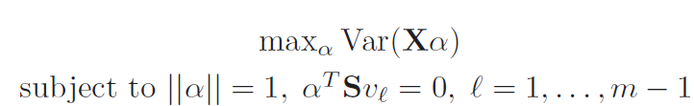
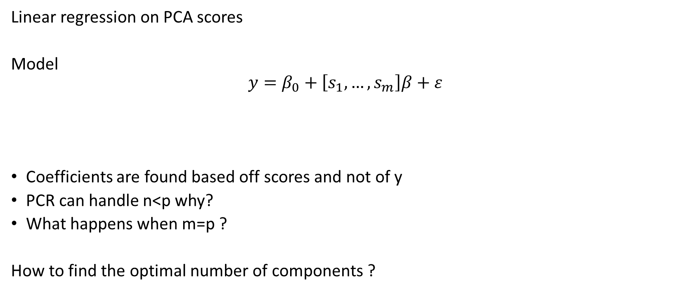
PCR model
Linear regression on PCA scores
Model
$$y=β_{0}+\left[s_{1},…,s_{m}\right]β+ε$$
Coefficients are found based off scores and not of y
PCR can handle n<p why?
What happens when m=p ?
How to find the optimal number of components ?

Slide 5
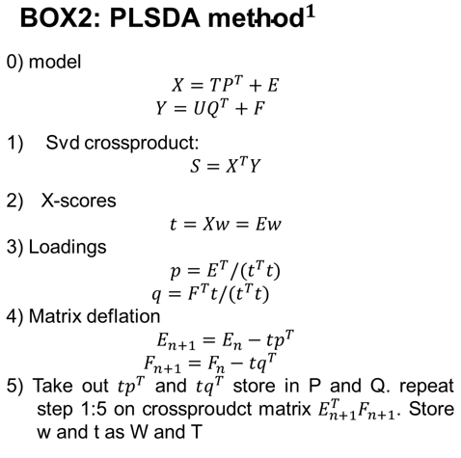
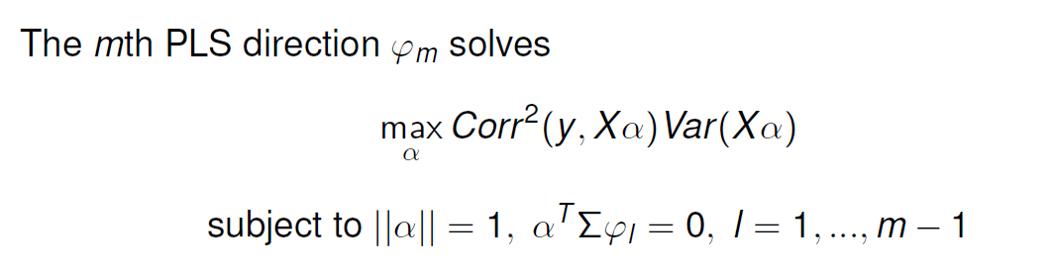
PLS model
Seeks to maximize the correlation of y and X under the constraint of the orthogonality of the scores
Details of how to solve this problem can be found in 4.7.2 in the RW book

Slide 6
PLS VS PCR
One is not better than the other
How do you figure out which one is best? (lets go to R!)

Slide 7
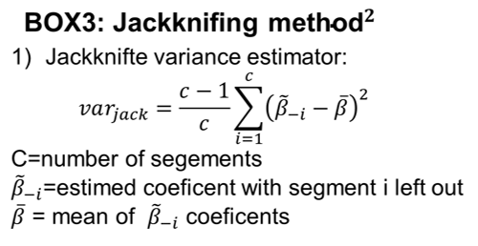
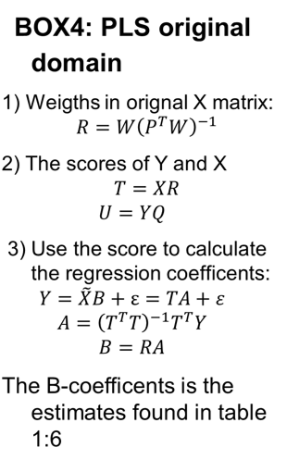
Resampling to original domain
Downside of latent modelling
Interpretation is hard!
Resample techniques can be applied
jackknifing the variance
Calculate back to the original domain from PLS/PCR model
This can all be done in R – be warned estimates may only be an indication of significance as the t-distribution for the PLS coefficients is only an assumption!!

